Slide 1
Session 9

Slide 2
Computational, Personal, Social Identities
Reflect on some quotes from Ivan:
‘I can't do:::o it!’
‘>Oh my god::d<. I'm SO DUMB’
‘I'm just not meant for coding’
What do they say about Ivan’s identity as a computer scientist?
How can we affirm Ivan’s computational identity?

Slide 3
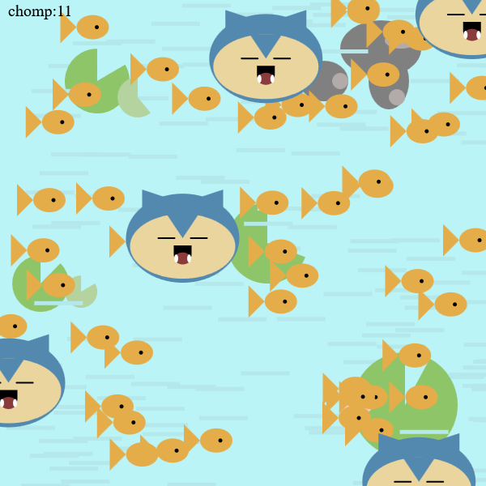
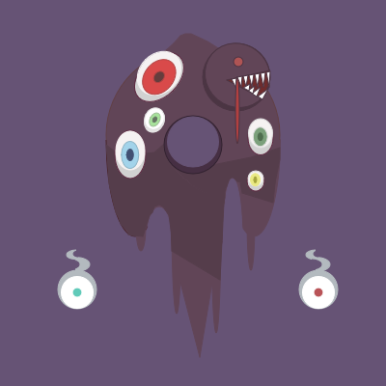
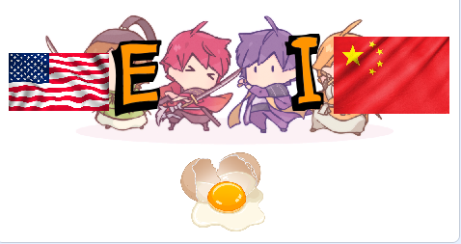
Computational, Personal, and Social Identities
“But if we can find an honest place for scientific thinking in activities that the child feels are important and personal, we shall open the doors to a more coherent, syntonic pattern of Learning.” (Papert, 1980, pp. 96-97).
“In the LOGO environment, children learn that teacher too is a learner, and that everyone learns from mistakes.” (Papert, 1980, p. 114).
Notes:
Mention that your students should see you code, lots of talk about this practice
Identity maps, identity includes race and ethnicity but also much more
Talk about previous day, feeling boxed in bycurriculum with a “right” answer

Slide 4
Goals
Reflect on feedback from yesterday’s sessions
Revise your resources after peer feedback
Whole group share out

Slide 5
Reflection on resource feedback (5 minutes)
What feedback did you receive that you want to incorporate into your pedagogy or resource?
What did you see from a partner that you would like to incorporate into your pedagogy or resource?

Slide 6
Resource Revision (30 minutes)
Continue to work on your resource and incorporate feedback.
Continue to consider:
Open-endedness
How can you make room for a variety of student solutions?
Conflict
How can you clarify and balance student and instructor goals during debugging?
Emotion
How can you leverage and support student emotion during debugging?

Slide 7
Whole group share out (30 minutes)
Spend a few minutes sharing out your work!
What resource(s) did you create?
What are the next steps?
Please feel free to add any resources to the shared folder

